Slide 1
Malignant comments classification
By
Satarupa goswami

Slide 2
Introduction
With the online world expanding exponentially many have the opportunity to express themselves and the words convey feelings which at times convey hate. These words which can be used to start online movements to start wars within countries. In fact, these hateful words are a serious problem that is worth looking into. If there were a way to control this spread of hatred then everyone might feel a little better.
So, the idea is to help separate the hateful words and filter them. It can be done by building a classification model. Which will help , control the spread of hate , cyberbullying online.

Slide 3
Problem statement
The proliferation of social media enables people to express their opinions widely online. However, at the same time, this has resulted in the emergence of conflict and hate, making online environments uninviting for users. Although researchers have found that hate is a problem across multiple platforms, there is a lack of models for online hate detection.
Our goal is to build a prototype of online hate and abuse comment classifier which can used to classify hate and offensive comments so that it can be controlled and restricted from spreading hatred and cyberbullying.

Slide 4
About the dataset
The data set contains the training set, which has approximately 1,59,000 samples and the test set which contains nearly 1,53,000 samples. All the data samples contain 8 fields which includes ‘Id’, ‘Comments’, ‘Malignant’, ‘Highly malignant’, ‘Rude’, ‘Threat’, ‘Abuse’ and ‘Loathe’.
The label can be either 0 or 1, where 0 denotes a NO while 1 denotes a YES. There are various comments which have multiple labels. The first attribute is a unique ID associated with each comment.

Slide 5
Tools used
pandas
NumPy
seaborn
matplotlib.pyplot
scikit-learn

Slide 6
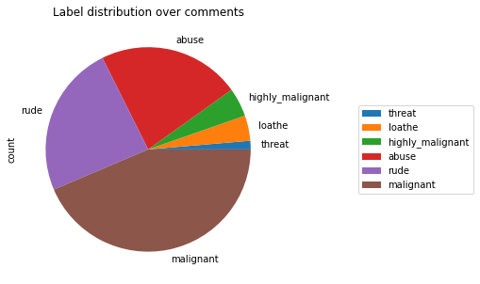
Exploratory Data Analysis
This basically shows how the distribution is over all the different binary columns which classifies the words as malignant , highly_malignant , loathe, threat, rude, abuse.

Slide 7
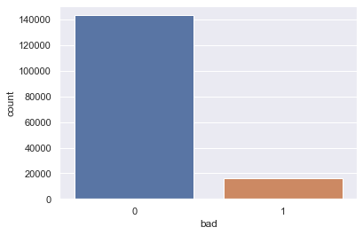
Data engineering
Prior columns were merged into a single column as ‘bad’.
Where 0 is a bad word and 1 is considered to be not a bad word.

Slide 8
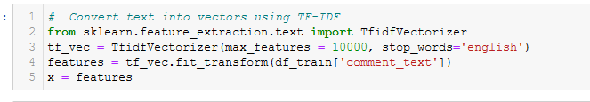
Approach to conversion
I have used TfidfVectorizer to convert text into vectors.

Slide 9
Models
The algorithms used were :
Logistic Regression
KNN Classifier
RF Classifier
XGBoost Classifier
The metric used to measure these classifiers are ‘LOG-LOSS’ , ‘AUC_ROC’, Using Precision , Recall , F1Score.
Of all the classifiers used RF Classifier had the best AUC_ROC score which enabled it to be the classifier used to obtain the final scoring and evaluation of the dataset.

Slide 10
conclusion
As the internet finds new homes to expand to, along with it the opportunities it offers and also it’s contretemps. Now, more than ever is the requirement for moderation. Moderation is something that doesn’t sit well with the current world of decentralization, but some sort control needs to be implemented so as to protect the vast audience of the digital era. As, we are ushering in a new world of digital revolution, it is in our hands to create something that will make the world better for the coming generations.

Slide 11
Thank you for your attention
Any Question or query?
Contact Information :
Email : goswamisatarupa92@gmail.com

